Slide 1




AEye
Department of Computer Science
Banasthali Vidyapith, Rajasthan
Developed By: CS39
Vidhu Chaudhary (BTBTC18213)

Slide 2
Table of contents
What is AEye?
Inspiration for AEye
Technology
Application Interface
Functionality of AEye
Conclusion
References

Slide 3
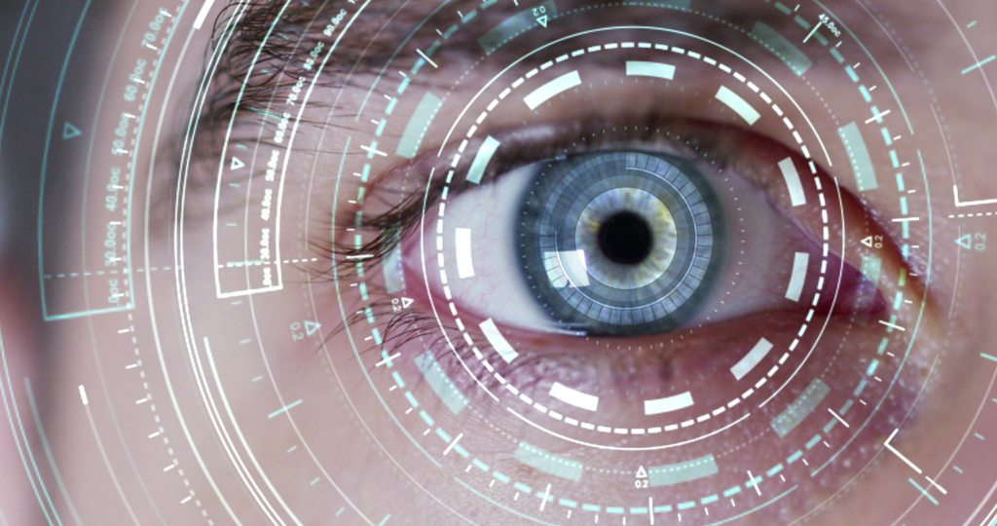
What Is AEye?
AEye - Artificial Eye, is an aided technology designed to act as a pair of eyes for the visually impaired.
AEye is an object detection system implemented using an android application for helping the users to detect common day to day objects in one’s vicinity in real time.

Slide 4
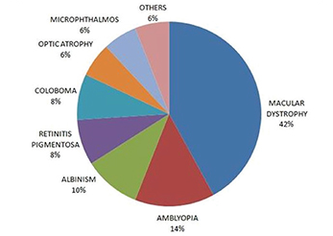
Inspiration For AEye
Visually Impaired People confront many problems in identifying objects in their surroundings.
Globally, the number of people of all ages visually impaired is estimated to be 285 million and approximately 246 million have low vision (severe or moderate visual impairment ). In India itself, 62 million people are affected with visual impairment.
Most common types of visual impairment
are:

Slide 5
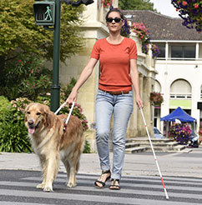
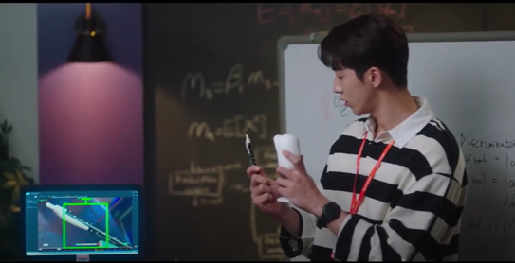
Although, numerous gadgets are invented for their aid but they do not provide a comfortable user experience for everyday life.
Maintenance and use of these gadgets require a good amount of expenses.
AEye attempts to provide an easy, approachable and free of cost solution for this reason.
Notes:
// eg for high cost gadget, portability, bhul gye toh kya hoga,walking stick is very inconvenient to use as it uses battery etc.

Slide 6
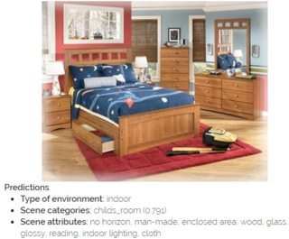
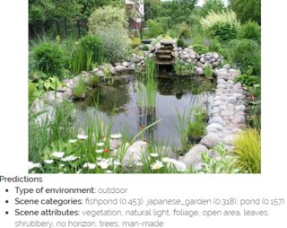
Notes:
Screenshots,portability,senti dialog, business model investors. Future - two way communication facilitate

Slide 7
Technology
Computer Vision is the technology used, which further makes use of deep learning as the state of art method to perform object detection.
This is combined with Android Mobile Application to give the users a friendlier way of implementation.

Slide 8
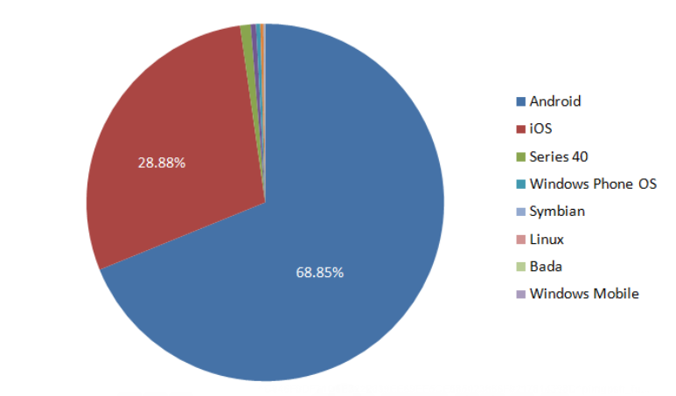
Visually impaired people have limited resources available and therefore, android application is used because it can reach a wide range of users.

Slide 9
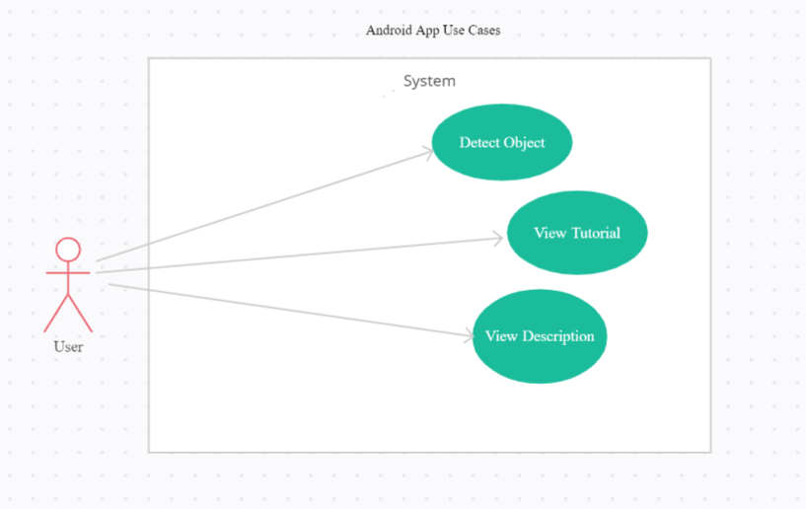
Use Case Diagram

Slide 10
Functionality Of AEye
Available models for object detection:
R-CNN: RCNN uses region proposal methods to generate possible bounding boxes in an image. Then, it applies various ConvNets to classify each box. The slow test-time, complex training pipeline and the large storage does not fit into our application.
Fast R-CNN: Fast R-CNN max-pools proposed regions and combines the computation of ConvNet for each proposal of an image and outputs features of all regions at once. The pipelines of this method is still relatively complex and hard to optimize.
YOLO: Considering the requirement of real-time object detection, in this project, we use You Only Look Once (YOLO) model. YOLO could efficiently provide relatively good object detection with extremely fast speed.

Slide 11
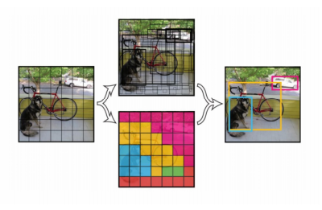
Advantages of YOLO
Fast,Good for real-time processing.
Predictions (object locations and classes) are made from one single network. Can be trained end-to-end to improve accuracy.
YOLO is more generalized. It outperforms other methods when generalizing from natural images to other domains like artwork.
Region proposal methods limit the classifier to the specific region. YOLO accesses to the whole image in predicting boundaries. With the additional context, YOLO demonstrates fewer false positives in background areas.
YOLO detects one object per grid cell. It enforces spatial diversity in making predictions.

Slide 12

Dependencies
OpenCV : Open Source Computer Vision library
MS-COCO : Microsoft Common Objects in Context is a dataset containing a vast array of objects that we regularly encounter in everyday life.
API : Two major Application Programming Interfaces used in this project are, Google Cloud Vision API and Text to speech API.

Slide 13
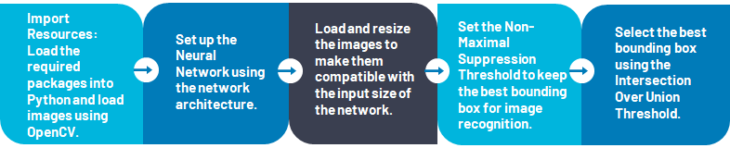
Procedure for Object Detection
Finally, perform Object Detection with the model and display the required characteristics of the object.

Slide 14
Notes:
A simple demonstration of object detection system in real time

Slide 15
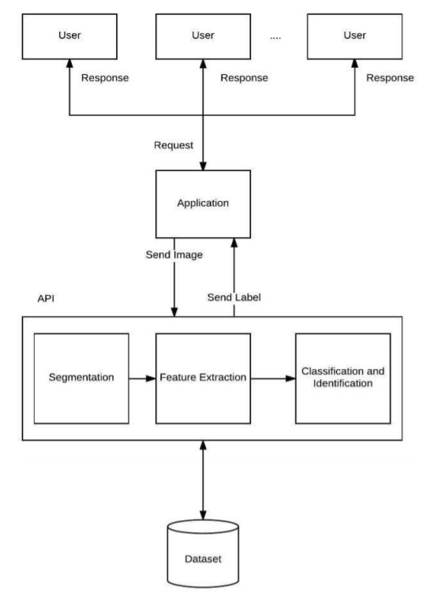
Architectural Diagram of the System

Slide 16
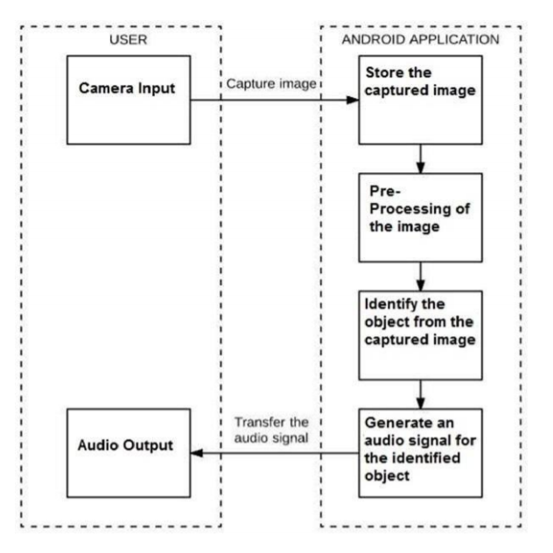
Module Diagram of the System

Slide 17
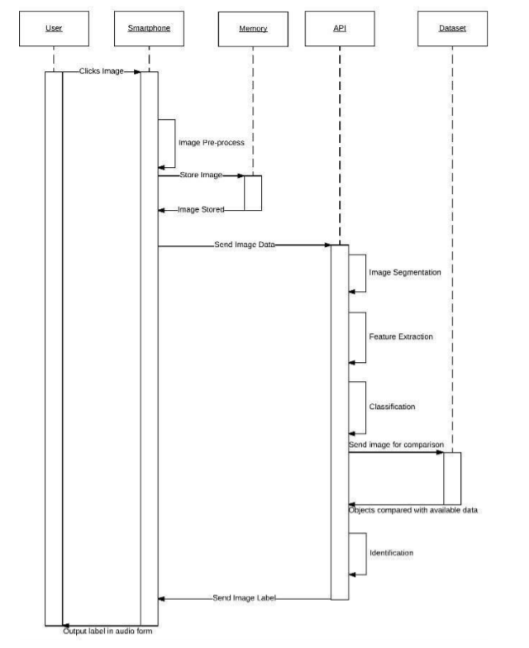
Sequence Diagram of the System

Slide 18
Conclusion
The aim of the project is to develop an application that can help the visually impaired people to detect the objects in their surroundings. The team realized that due to such disability, people feel lost and devastated. What is ordinary for most isn’t ordinary for all. Therefore, this technology is an attempt to protect their everyday lives. It is reliable and can be incorporated as a part of an everyday life since it focuses on identifying the most common things in the surrounding environment.

Slide 19
References
[1] R. Rajwani , D. Purswani , P. Kalinani , D. Ramchandani, I. Dokare , “ Proposed
System on Object Detection for Visually Impaired People ”, International
Journal of Information Technology, vol. 4, no. 1, Mar ,2018.
[2] Joseph Redmon and Anelia Angelova, Real-Time Grasp Detection Using
Convolutional Neural Networks (ICRA), 2015.
[3] Joseph Redmon, Santosh Divvala, Ross Girshick, and Ali Farhadi. You only look
once: Unified, real-time object detection. arXiv preprint
arXiv:1506.02640,2015.
[4] https://github.com/Garima13a/YOLO-Object-Detection

Slide 20
THANK YOU!

